Slide 1
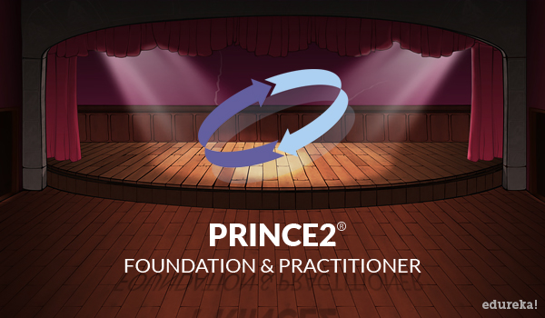
Demystifying Prince2 : why does it matter?
View PRINCE2 Foundation & Practitioner Certification course details at http://www.edureka.co/PRINCE2-foundation-and-practitioner-course-curriculum
For Queries during the session and class recording:
Post on Twitter @edurekaIN: #askEdureka
Post on Facebook /edurekaIN
For more details please contact us:
US : 1800 275 9730 (toll free)
INDIA : +91 88808 62004
Email us : sales@edureka.co

Slide 2
Agenda
An In this module we will understand:
What is PRINCE2 & where it all began?
Is Prince2 suitable for Non-IT projects
Who uses Prince2
Prince2 Exam Format
Prince2 Exam Methodology

Slide 3

What is PRINCE2® ?
Project Management?
UK Styled?
Controlled Environment?

Slide 4
Decoding Prince2
-> Stands for Projects in Controlled Environments
->Easy to Learn & Flexible for all Projects
-> 1,000,000+ Practitioners Worldwide
->Provides guidance and essentials of running a project.

Slide 5
Benefits of Prince2
Quality
Proven methods and globally-recognized solutions, for total success
Budget
Flexible enough to fit in with any budget – regardless of project size
Timescale
Desired targets met, on time every time. No surprises, just seamless project management

Slide 6

Birth of Prince2
Proj…Ma…

Slide 7
PROMPTII
Project Resource Organization
Management and Planning Techniques
A project management method
developed by Simpact Systems Ltd.
PRINCE2
Projects IN Controlled Environments
Published by the UK Government agency CCTA,
Projects in Controlled Environments (PRINCE)
became the UK standard for all government information systems projects.
PRINCE2
Projects IN Controlled Environments 2
An upgrade to PRINCE was considered to be in
order and the development was contracted out but
assured by a virtual committee spread among 150
European organizations.
PRINCE2
Major Revision
A major revision has seen the method made
simpler and more easily customizable, a common request from users.
1975
1989
1996
2000

Slide 8



The Prince2 Power
Since its development in 1989, PRINCE2 has been successfully adopted by thousands of project managers around the world. Today, it is the most widely-used project management framework.
Over 150 countries
Millions in ROI
19 Different Languages

Slide 9
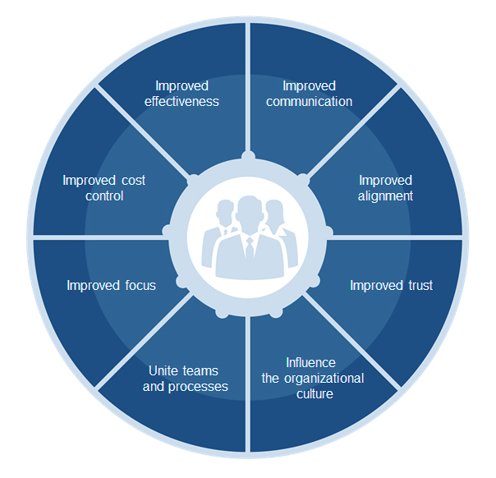
PRINCE2®Benefits
PRINCE2: improved project
delivery, improved performance,
improved business results

Slide 10

Benefits: FOR AN INDIVIDUAL
PRINCE2: successful project
management, improved project
delivery, enhanced career
advancement.
Qualifications
recognized
around
the world
How to start
Your projects
Improve your
position
How to improve
your delivery
Terminology that
is common
How to close
your
projects
Clearly
understand
your role
How to
structure
a project
Structured
approach

Slide 11
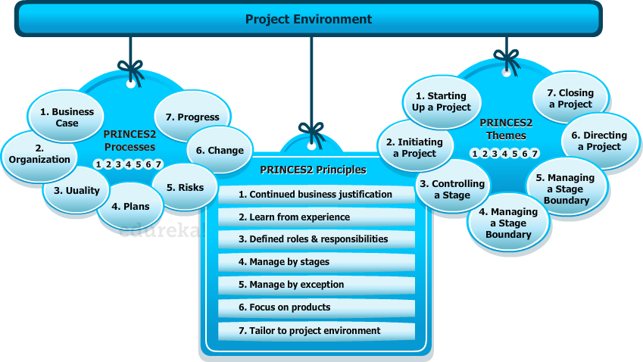
PRINCE2® Integrated Environment
PRINCE2
PRINCE2
PRINCE2

Slide 12
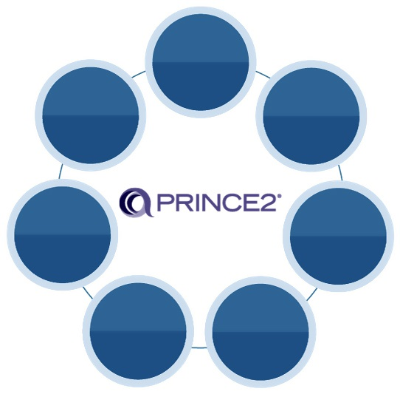







Themes
7 crucial themes, limitless benefits:
Sets out the justification for each and every project, clearly highlighting what is required and, crucially, when.
Project control mechanisms are clearly set out for key project personnel.
Business
Case
Project roles and responsibilities are clearly defined, for truly seamless project management.
Progress
Organization
Having a clear definition of a project’s configuration management, issue management and change control are key to all you seek to achieve.
A generic method based on proven principles, when you adopt PRINCE2, quality is assured.
Change
Quality
Specialist aspects of the project can be easily integrated with the PRINCE2 method, for true success.
Risk analysis and management are key to any project’s successful delivery.
Planning
Risk

Slide 13






Principles
7 key principles give you the reassurance, confidence of knowing that everything is covered – at each and every stage:
The PRINCE2 project team should have a clear organizational structure and involve the right people in the right tasks.
PRINCE2 projects focus on the product definition, delivery and quality requirements.
Defined roles and
responsibilities
PRINCE2 projects should be planned, monitored and controlled on a stage-by-stage basis.
Focus on
products
Manage by
stages
Is there a justifiable reason for starting the project that will remain consistent throughout its duration?
PRINCE2 project have defined tolerances for each project objective to establish limits of delegated authority.
Continued business
justification
Manage by
exception
PRINCE2 project teams should continually seek and draw on lessons learned from previous work.
PRINCE2 is tailored to suit the project’s environment, size, complexity, importance, capability and risk.
Tailoring
Learn from
experience

Slide 14
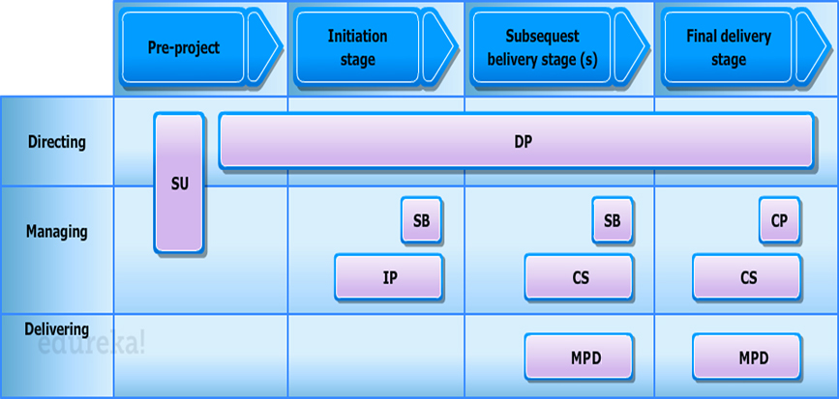
Processes
1 Starting up a Project
2 Initiating a Project
3 Directing a Project
4 Controlling a Stage
5 Managing Product Delivery
6 Managing Stage Boundaries
7 Closing a Project
Example of where process would fit into a four stage project
Stages of a project

Slide 15

Qualifications
FOUNDATION – at a glance
The benefit of this core qualification is simple: to confirm you have sufficient knowledge and understanding of the PRINCE2 method to be able to work effectively with (or as a member of) a project management team working within an environment supporting PRINCE2.*
EXAMINATION – in more detail
Multiple choice examination questions
75 questions per paper
Five trial questions (not counted in scores)
Pass: 35 marks required (out of 70 available) – 50%
Closed book.
*The Foundation qualification is also a prerequisite for the Practitioner qualification.

Slide 16

Qualifications
PRACTITIONER – at a glance
The purpose of the Practitioner qualification is to confirm whether the candidate has achieved sufficient understanding of how to apply and tailor PRINCE2 in a scenario situation. A successful Practitioner candidate should (with suitable direction) be able to start applying the method to a real project – but may not be sufficiently skilled to do this appropriately for all situations.*
EXAMINATION – in more detail
Multiple choice examination questions
Objective testing
Eight questions - 10 question items per question, each worth one mark
44 marks or more required to pass (out of 80 available) – 55%
Two-and-a-half hours’ (150 minutes) duration, no additional reading time
Open book exam (official PRINCE2 manual only).
*Individual project management expertise, complexity of the project and the support provided for the use of PRINCE2 in their work environment will all be factors that impact what the Practitioner can achieve.

Slide 17

Qualifications
PROFESSIONAL – at a glance
The PRINCE2 Professional qualification is the next step for PRINCE2 Practitioners. This level will test your ability to manage a non-complex PRINCE2 project across all aspects of the project lifecycle.
EXAMINATION – in more detail
Multiple choice examination questions
Objective testing Two-and-a-half day residential Assessment Centre
Group activities and exercises
Based on a fictional project case study
Assessment is against 19 individual performance criteria.*
*There is no written examination.

Slide 18
For Practitioners & Registered Practitioners
All PRINCE2® Practitioners should be re-registered within 5 years of their original certification
This Re-Registration comprises a 1-hour examination set at the same standard as the Practitioner examination

Slide 19
PRINCE2 Market Trends
According to Popular Jobs site , itjobswatch.co.uk, the average pay for PRINCE2 Certified Practitioners is 50,000 Pounds in the UK alone!
Some of the top positions PRINCE2 Certified Practitioners include Project Director, Project Coordinator, IT Project Manager etc.,
As per Reports provided by PayScale.com, the demand for PRINCE2 Certified Practitioners with the following data:
Designation | Pay Bracket / Per Annum
Project Manager, Information Technology | $42,282 -$102,285
Senior Project Manager, IT | $92,000 - $142,500

Slide 20
How it Works

Slide 21
Course Topics
Module 1
PRINCE2 ® Integrated Elements
Module 2
Principles
Module 3
Themes
Module 4
Processes
Module 5
Tailoring PRINCE2®
Module 6
PRINCE2® Practitioner – Business Case Studies

